Slide 1
This is the way…or is it?
The impact of climate scenario choice on stress-test outcomes across 5 climate scenarios

Slide 2
Authors: Antonio Buller, Franziska Fischer, Matteo Gasparini, Moritz Bär, Jakub Cervenka, Gireesh Shrimali, Jakob Thomä
FUNDING:
LIFEPACTA2
About 1in1000
1in1000 is research collaboration between Oxford Sustainable Finance Iniaitiatve and Theia Finance Labs (Formerly 2° Investing Initaitive Germany) that brings together new & existing research projects on long-termism, climate change, and (inter-)connected future risks for financial markets, the economy, and society. Its objective is to develop evidence, design tools, and build capacity to help financial institutions and supervisors to mitigate and adapt to future risks and challenges. The programme focuses on climate change (inter-) connected risks and challenges, notably risks stemming from ecosystem services and biodiversity loss, as well as risks from social cohesion and resilience.
About Theia Finance Labs
Theia Finance Labs (formerly 2° Investing Initiative Germany) is an independent, non-profit think tank incubating research solutions for the financial sector that help solve the climate crisis. The Theia Finance Labs name is inspired by the Greek goddess of sight, the light of the blue sky, and the value of gold, Theia, and by the Greek word Aletheia, which means “disclosure” or “truth”, literally “the state of not being hidden”. The new brand thus mirrors our goal to develop evidence-based research and tools that shed light on the intersection of finance, climate change, and long-term risks. Theia operates as a 100% non-profit organization.

Slide 3
INTRODUCTION
The choice of scenarios in climate stress-test are generally recognized to be a key determinant of the outcomes of stress-test models
Climate scenario variables are the ‘value drivers’ that determine the production profiles of products and services and the evolution of both regulatory and market costs and prices. In light of the importance of scenarios, the Network for Greening the Financial System (NGFS) has selected a set of discrete scenarios designed to form the basis of their climate scenario and stress-test exercises.
Despite their prominence of climate scenarios, there is little to no work done to date on the exact impacts of the scenario choices on stress-test outcomes and the correlation between them.
While it is intuitive to consider scenario choices important in stress-test design, the lack of analysis on the degree of importance makes it hard to gauge the overall materiality of these choices. Such analysis is of course complicated by the fact that scenarios are not the only critical choice in stress-test design.
This note is the first public exercise quantifying the correlation between stress-test model outcomes using different scenarios, with a focus on the power sec.
Using a consistent model and consistent environmental / climate data input for a universe of 3,646 companies in the power sector across two NGFS scenarios (GCAM, REMIND) and three significant other scenario providers (Inevitable Policy Response, International Energy Agency, Institute for New Economic Thinking), the note allows users to understand both the relative impact of different scenarios on outcomes and the correlation between them.

Slide 4
Summary of key findings
FINDING #1: Scenarios with similar ambition levels may yield significantly different financial impacts.
FINDING #2: At firm level, there is limited to no correlation between different scenarios in terms of financial impacts.
FINDING #3: Even when filtering those companies that have a negative shock across scenarios, the overall shock levels can be dramatically different.
FINDING #4: Crucially, the difference between NGFS scenarios suggest that the NGFS scenarios have a limited impact on comparability.

Slide 5
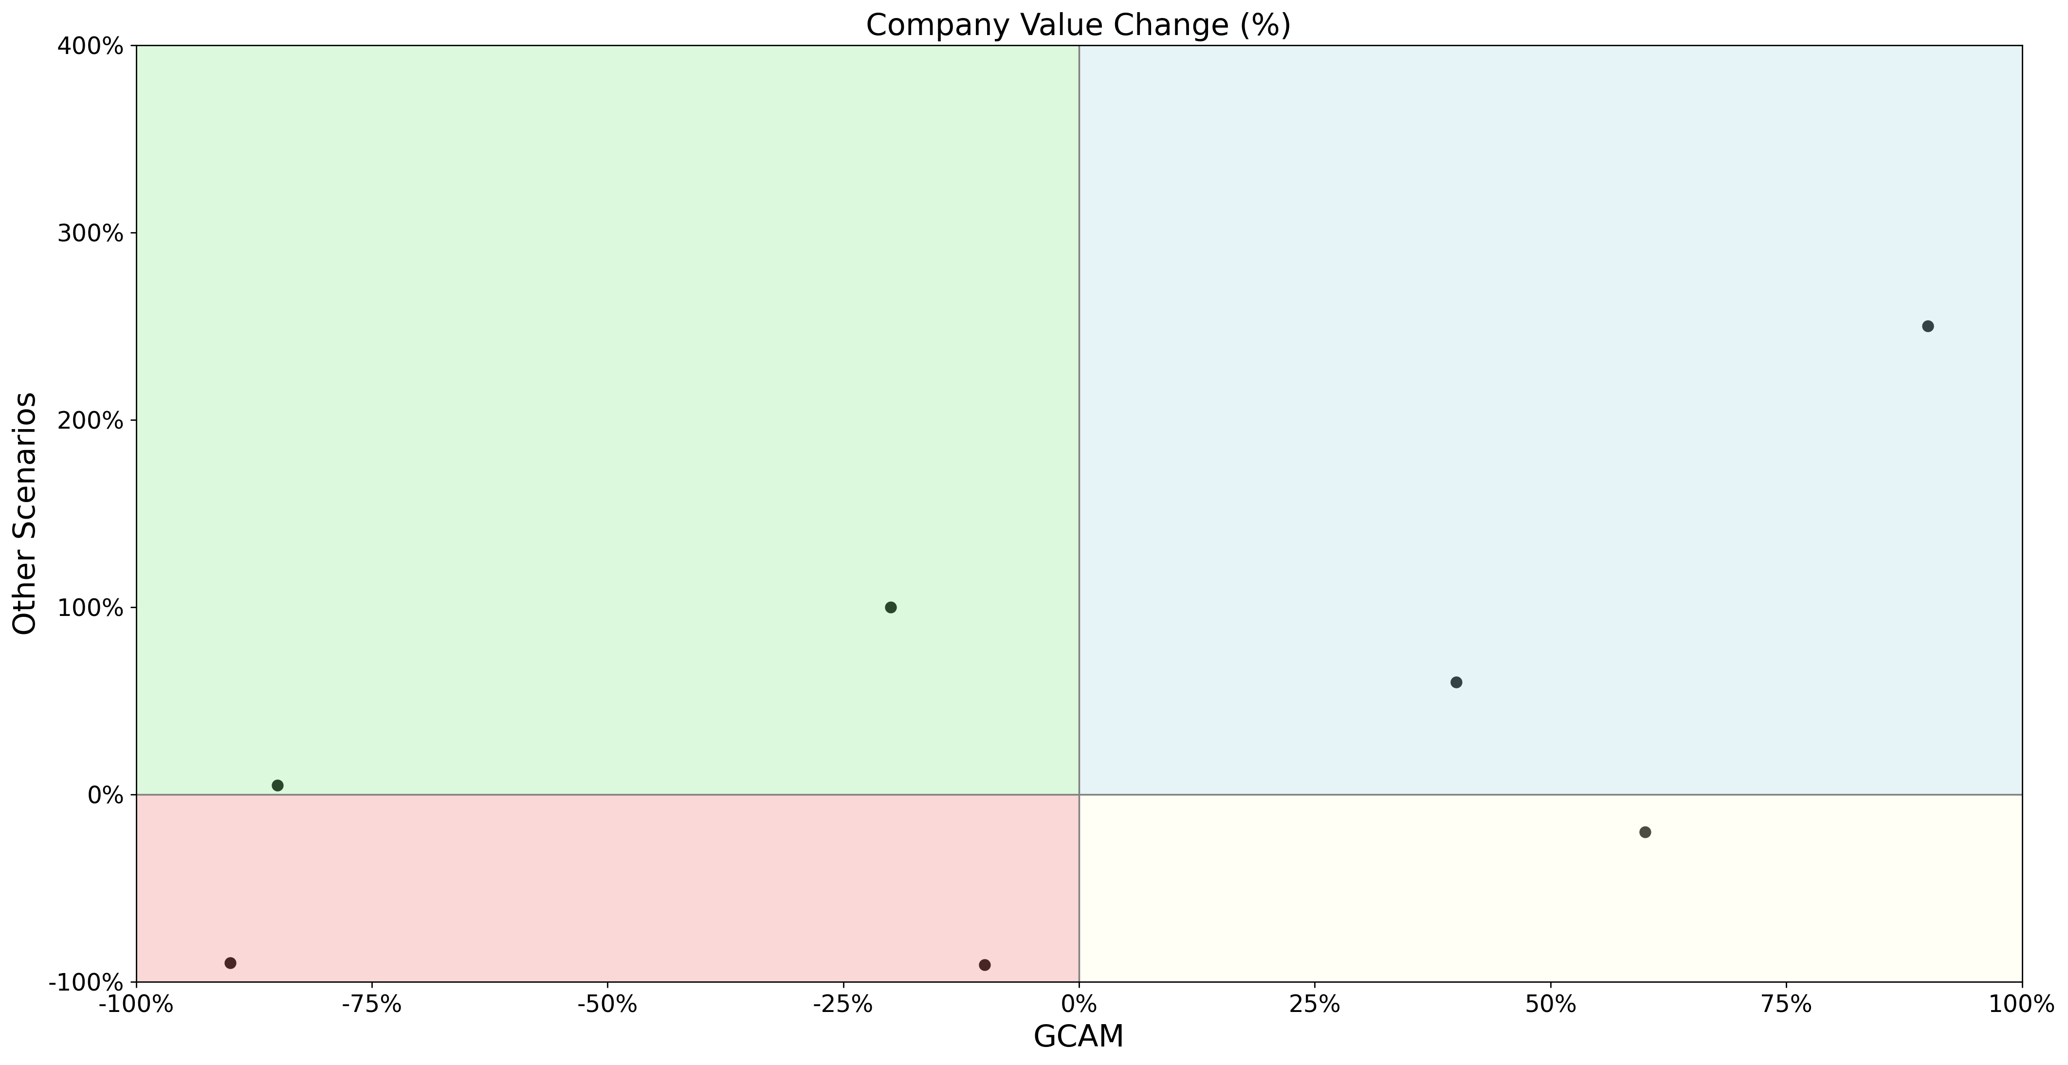
Explanatory chart to help readers follow and interpret the visuals in this note
The charts are provided for both valuation and PD losses. Note that for PD losses the charts reflect the change in probability of default and thus increased values suggest higher default probabilities (inverse to valuation shocks).
This company has a negative valuation shock in the stress-test model using the GCAM scenario and a positive shock in the stress-test model for another scenario.
This company has a positive valuation shock across both scenario inputs.
This company has a positive valuation shock in GCAM and negative in another scenario. This demonstrates that the “sign” of the difference between scenarios is not constant.
This company has a negative valuation shock across both scenarios, but in GCAM it loses roughly 10% of its value and in the other scenario almost 100%

Slide 6
Quick note on methodology
The analysis is based on a universe of 3,645 power companies globally. Data for the power companies is provided by AssetImpact. The stress-test model used is the 1in1000 T-Risk model. Further information on the methodology can be found at www.1in1000.com.
we integrate a variety of scenarios with the same overall target of below 2°C from four different scenario providers – the Network for Greening the Financial System (NGFS), the International Energy Agency (IEA), the Inevitable Policy Response (IPR) and the Institute For New Economic Thinking (INET) at the University of Oxford – into one consistent climate transition stress testing framework ‘TRISK’ developed by Baer et al. (2022), hosted and maintained by the 1in1000 Initiative. We show the difference in financial market risk – transition-related changes in the net present valuation (NPV) - and credit risk – transition related changes in the probability oif default (PD) - for a set of global energy firms in the power, oil, gas and coal sector across above-mentioned scenarios. Importantly, in our exercise we keep constant all other TRISK model assumptions, to isolate the effect of the different scenario pathways. This exercise closely follows acamdemic work by Gasparini et al. (2022), which outlines more in detail the analysis undertaken and provides an overview of the qualitiative and quantitive differences across the sceanrios used to help interpretability of our results.
The way in which the TRISK model is constructed allows to simulate a tail event affecting the valuation and probability of defaults of energy companies. In the model, some climate-adjusted economic parameters affect the physical production of firms, induce additional costs, and shift market shares according to the alignment of firms with decarbonisation pathways. This alters the firms’ cost structure and production mix across technologies and business units (e.g., electricity produced from solar or coal power plants) and impacts their income and profitability. Asset and firm-level impacts are translated into equity valuation changes, through a discounted cash flow model and subsequently into a time-horizon adjusted Merton credit risk framework. The model takes into consideration the comparative advantage of firms throughout the transition based on stipulated forward-looking production plans and scenarios around demand and unit cost developments. We use this model to neutralise the methodological differences and focus on the scale of climate uncertainty. For a more comprehensive review of the TRISK methodology refer to Baer et al. (2022).
We focus on two key scenario variables which are the input of the TRISK model: (1) the production decarbonisation trajectories per energy generation technology that is required in each scenario to achieve their respective climate mitigation outcomes; and (2) the evolution of the levelized cost of electricity (LCOE) for each technology, which represents the comparative cost advantages across firms’ production based on their technology mix. Loosely speaking, we analyse the impact of transition risk for each of the firms under different scenario assumptions around the associated speed and level of disruption created in the global energy mix, as well as different manifestations of the evolution of energy technology costs that impact the market share and cost structure of the analysed firms. Our analysis focuses on four scenarios, namely the IEA’s Sustainable Development Scenario (IEA), the NGFS Net Zero 2050 scenario (NGFS), IPR Forecast Policy Scenario and Required Policy Scenario, and INET’s Fast Transition scenario (INET). These scenarios depict significant variation in how the energy mix is changing in the transition and how costs for low and high-carbon technologies change. For instance, the speed of technological innovation is an important driver around the deployment of renewable energy and the scale of disruption across the energy system. Some studies highlight how a faster drop in the cost of renewable energy might lead to a faster uptake of renewables in the near future (Way et al., 2021). Importantly, some energy scenarios by the IEA do not properly account for these issues and have failed to realistically forecast the speed of renewable energy technology advance (Farmer et al. 2015).

Slide 7
FINDING #1: Scenarios with similar ambition levels may yield significantly different financial impacts

Slide 8
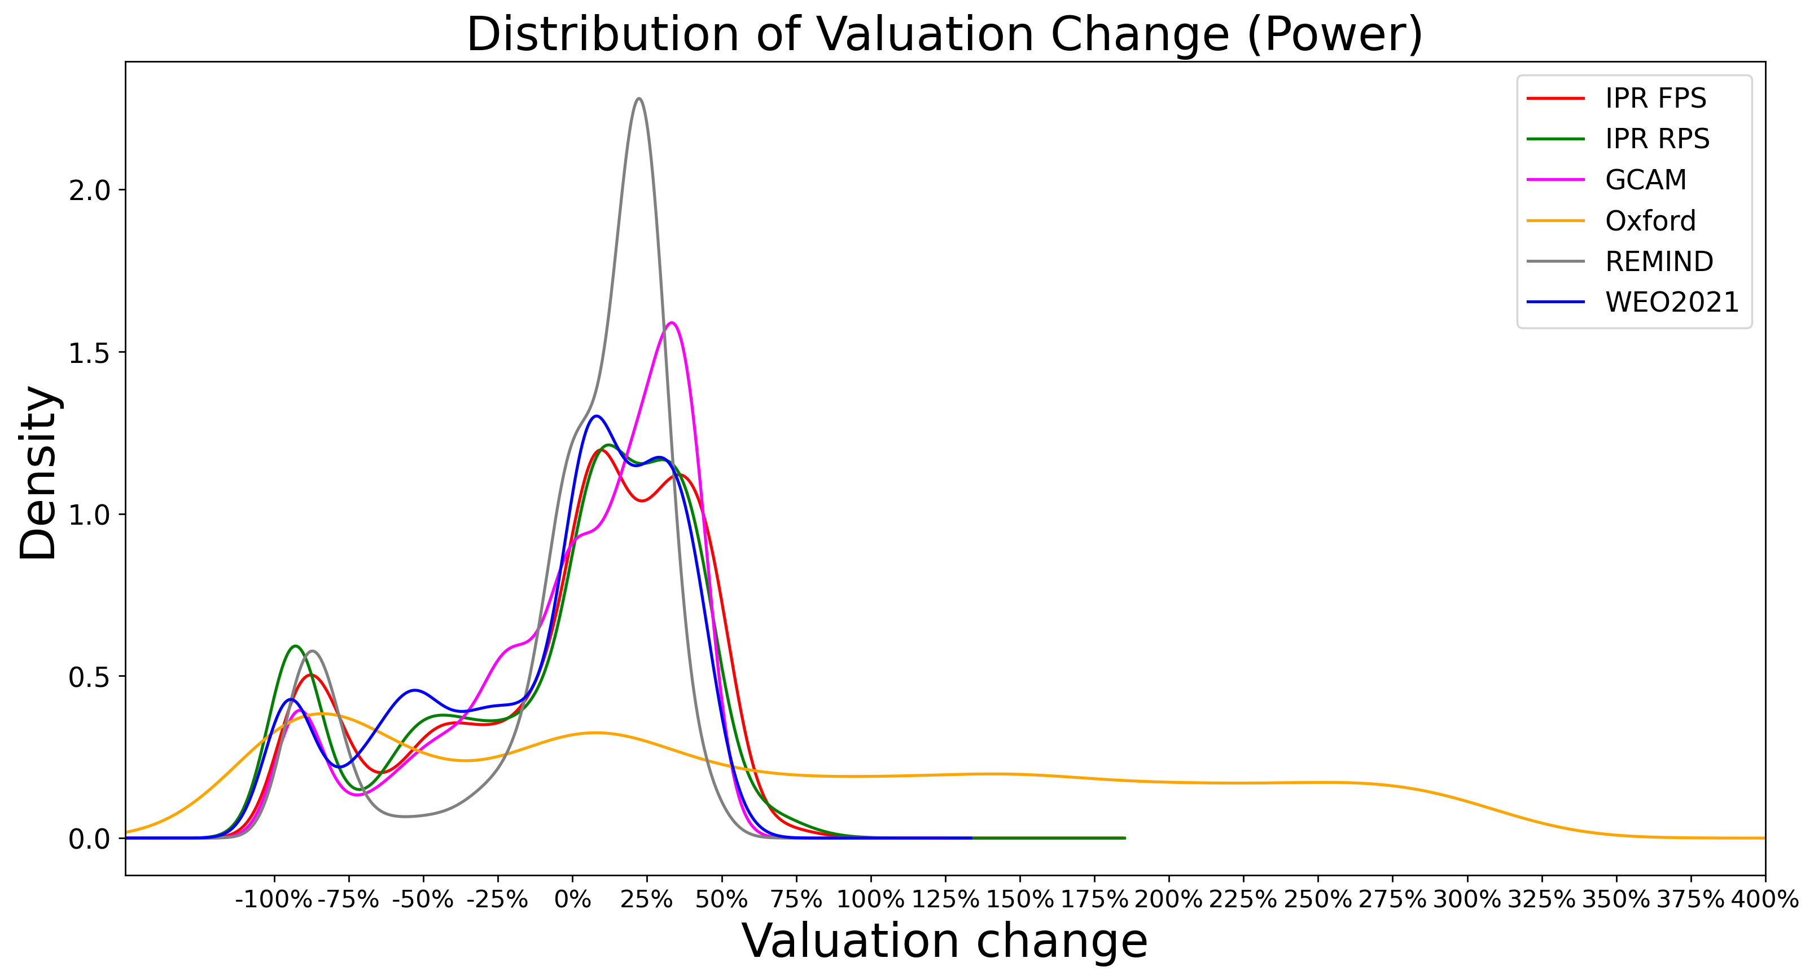
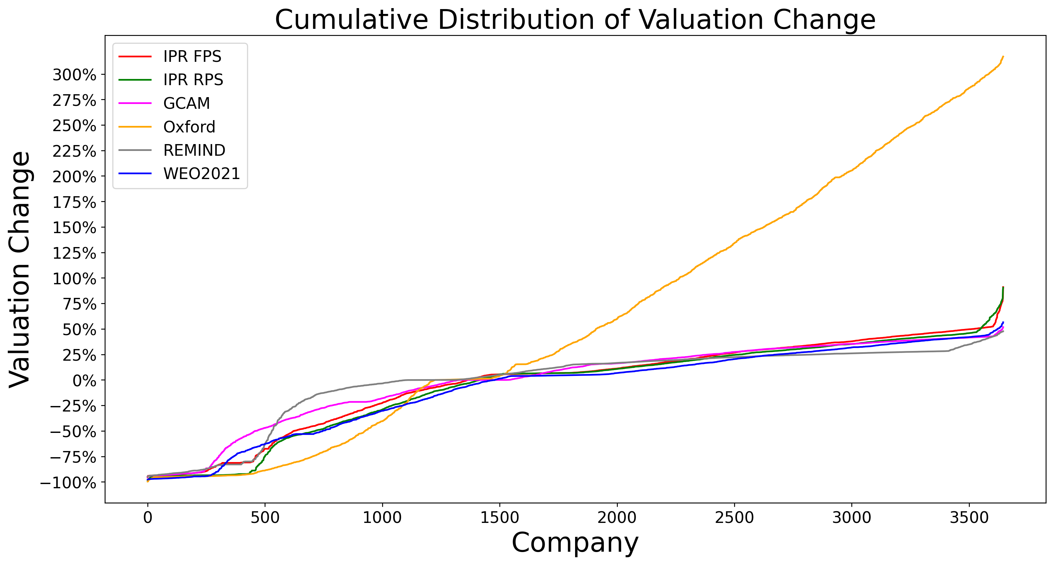
Key Finding #1: Scenarios with similar ambition levels may yield significantly different financial impacts
The figure below highlights the distribution of companies' value change across six scenarios.
The Oxford scenarios demonstrate both significantly higher down- and upside for power companies and the REMIND scenario the lowest. Whereas around 1,000 companies lose more than 20% of their value in the Oxford scenario, that number is around 500 for REMIND. The analysis highlights the potential significant ramifications of scenario choice by financial supervisors. It also highlights the small but meaningful number of “winners” from the transition. Given the impact of forward-looking production and capex plans in the T-RISK model, these winners are concentrated among companies driving the transition.
The second chart on distribution further highlights the dramatic differences where in the distribution companies may sit and the “two peaks” reality of climate scenarios across “no / limited impact and “high impact”, reinforcing the non-linearity and non-normal distribution of climate losses.

Slide 9
FINDING #2: At firm level, there is limited to no correlation between different scenarios in terms of financial impacts

Slide 10
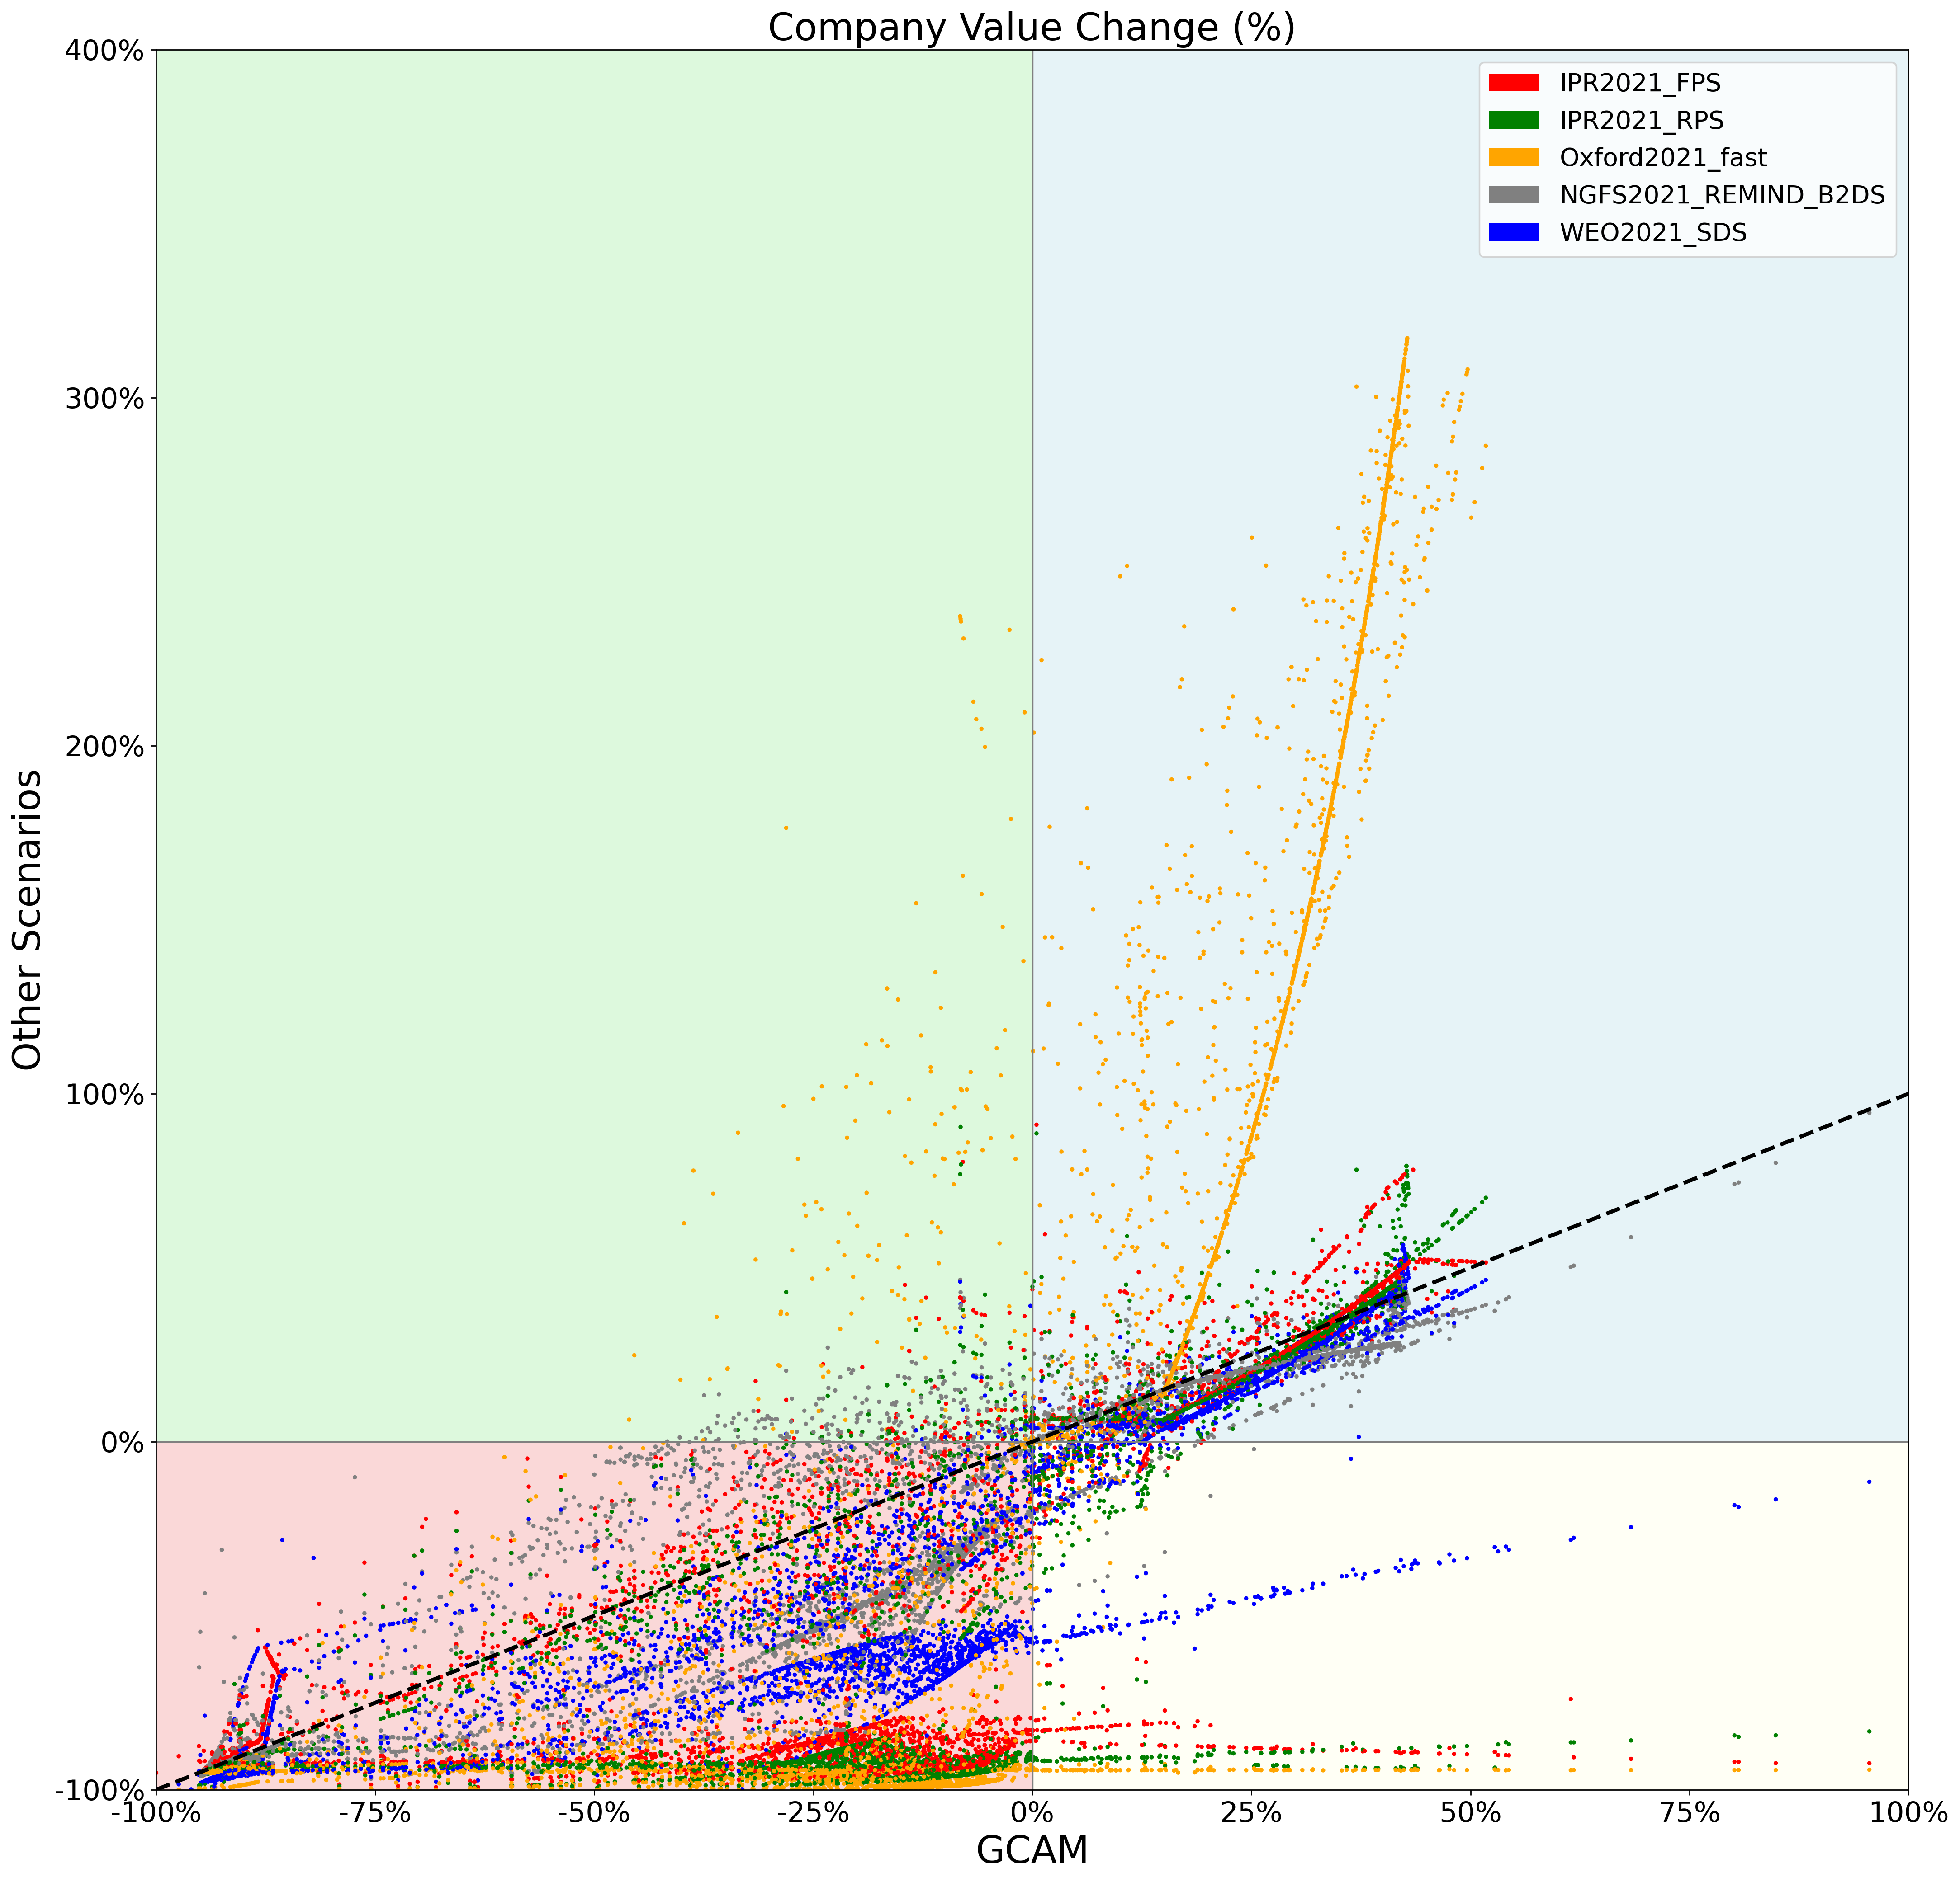
Key Finding #2: At firm level, there is limited to no correlation between different scenarios in terms of financial impacts
Companies find themselves in dramatically different positions on the distribution
A lage share of companies have scenario outcomes “with the wrong sign”, in other words where one scenario makes them a scenario “winner” and another a scenario “loser” (see the chart on right). In a handful of cases, this is so dramatic that one scenario suggests they will lose almost 100% of their value and another suggests they will nearly double their value.
Of course, the actual company profile is consistent, but key choices about the winning technologies and the cost-price profile of different energy technologies (renewables, hydropower, nuclear power) dramatically changes the picture

Slide 11
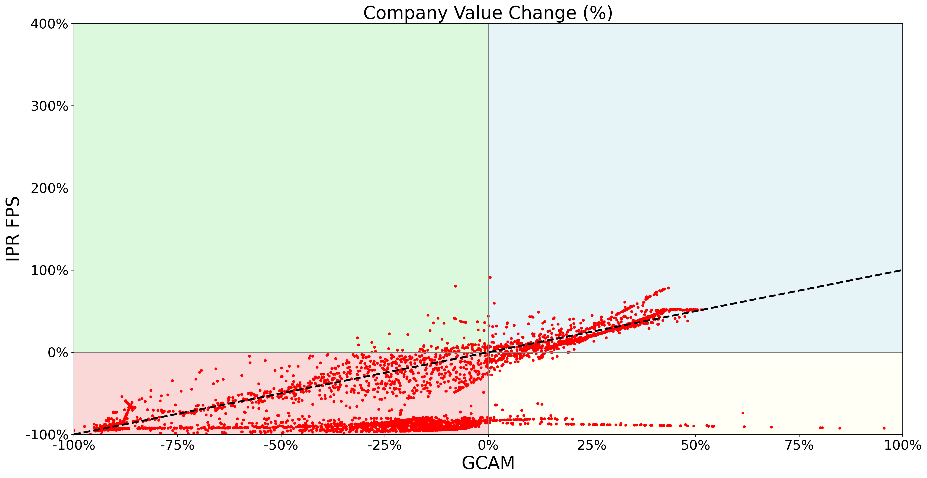
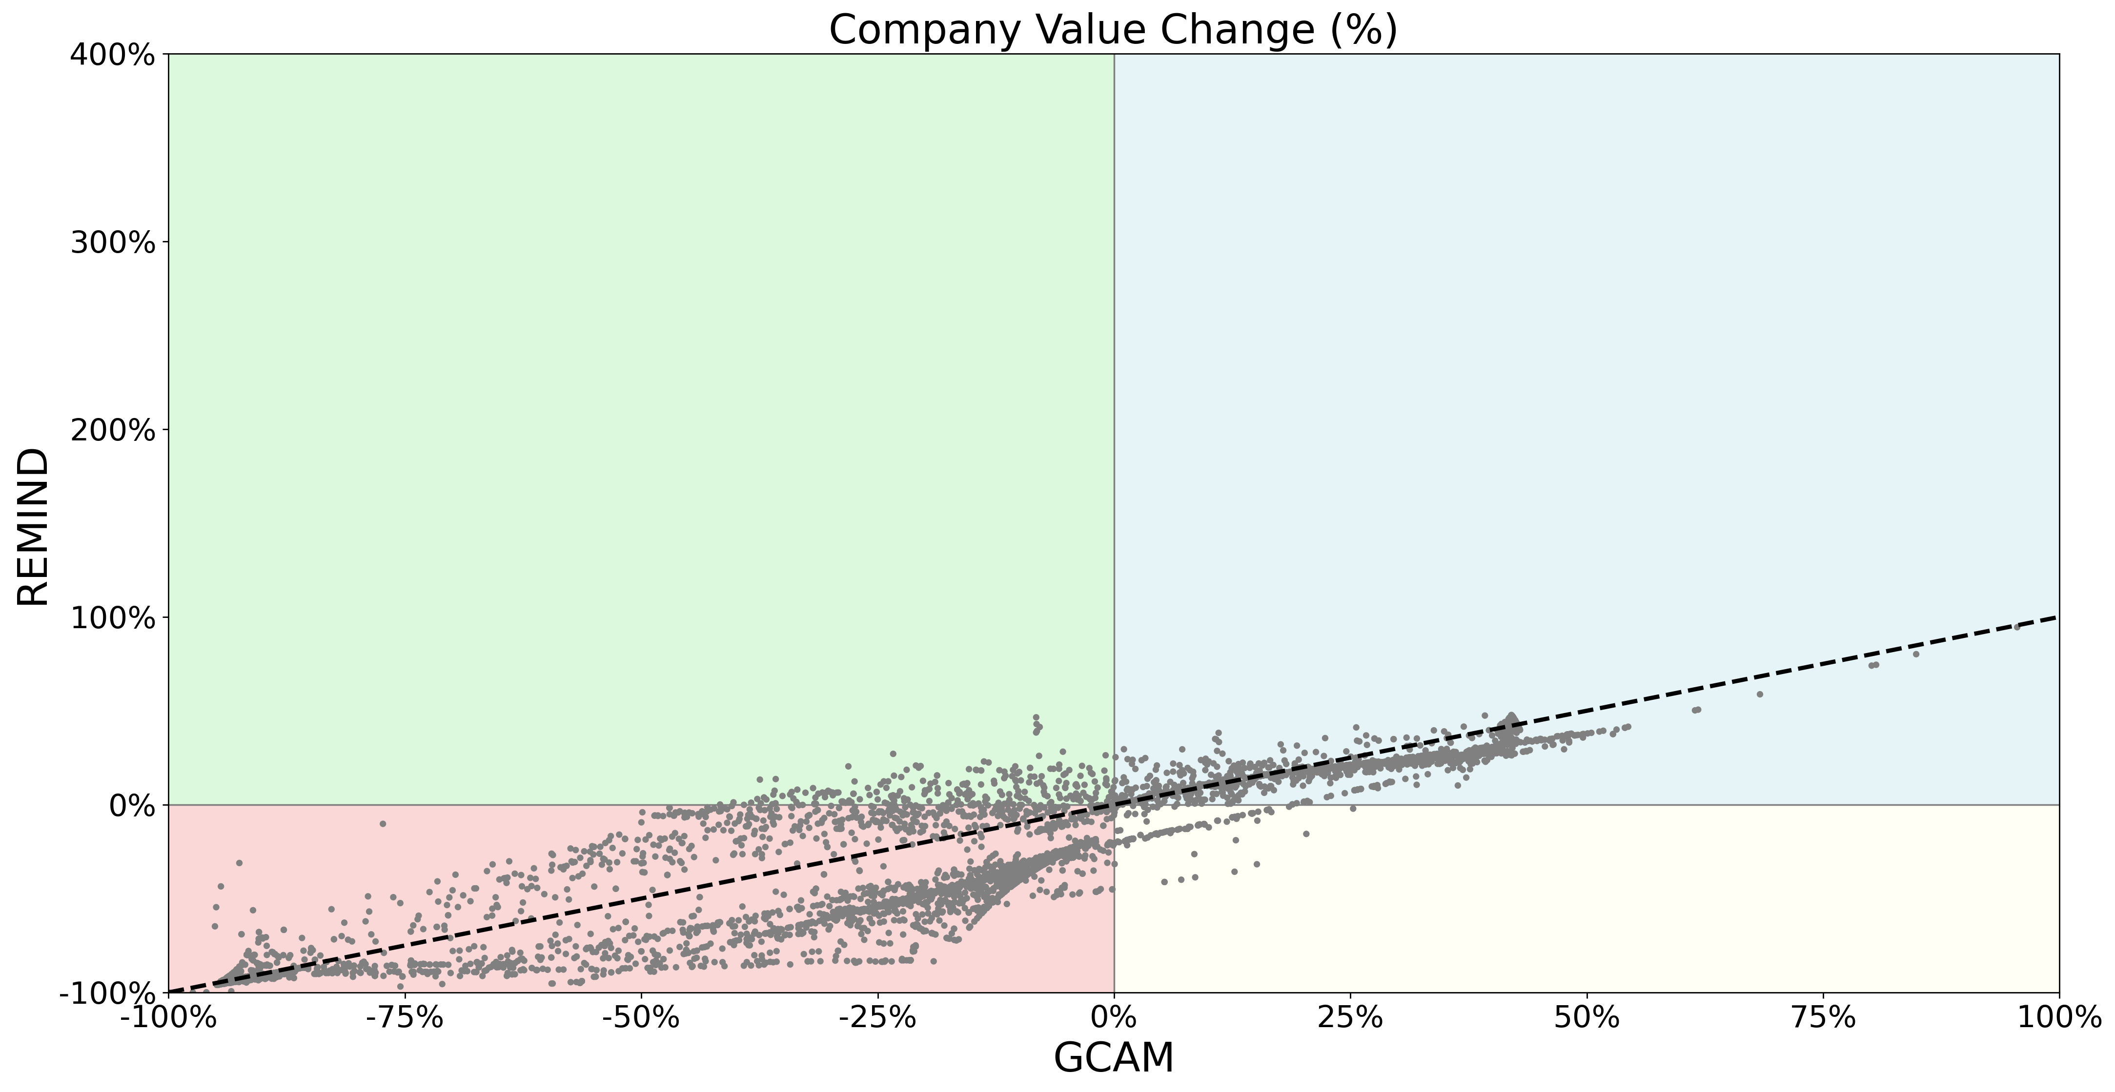
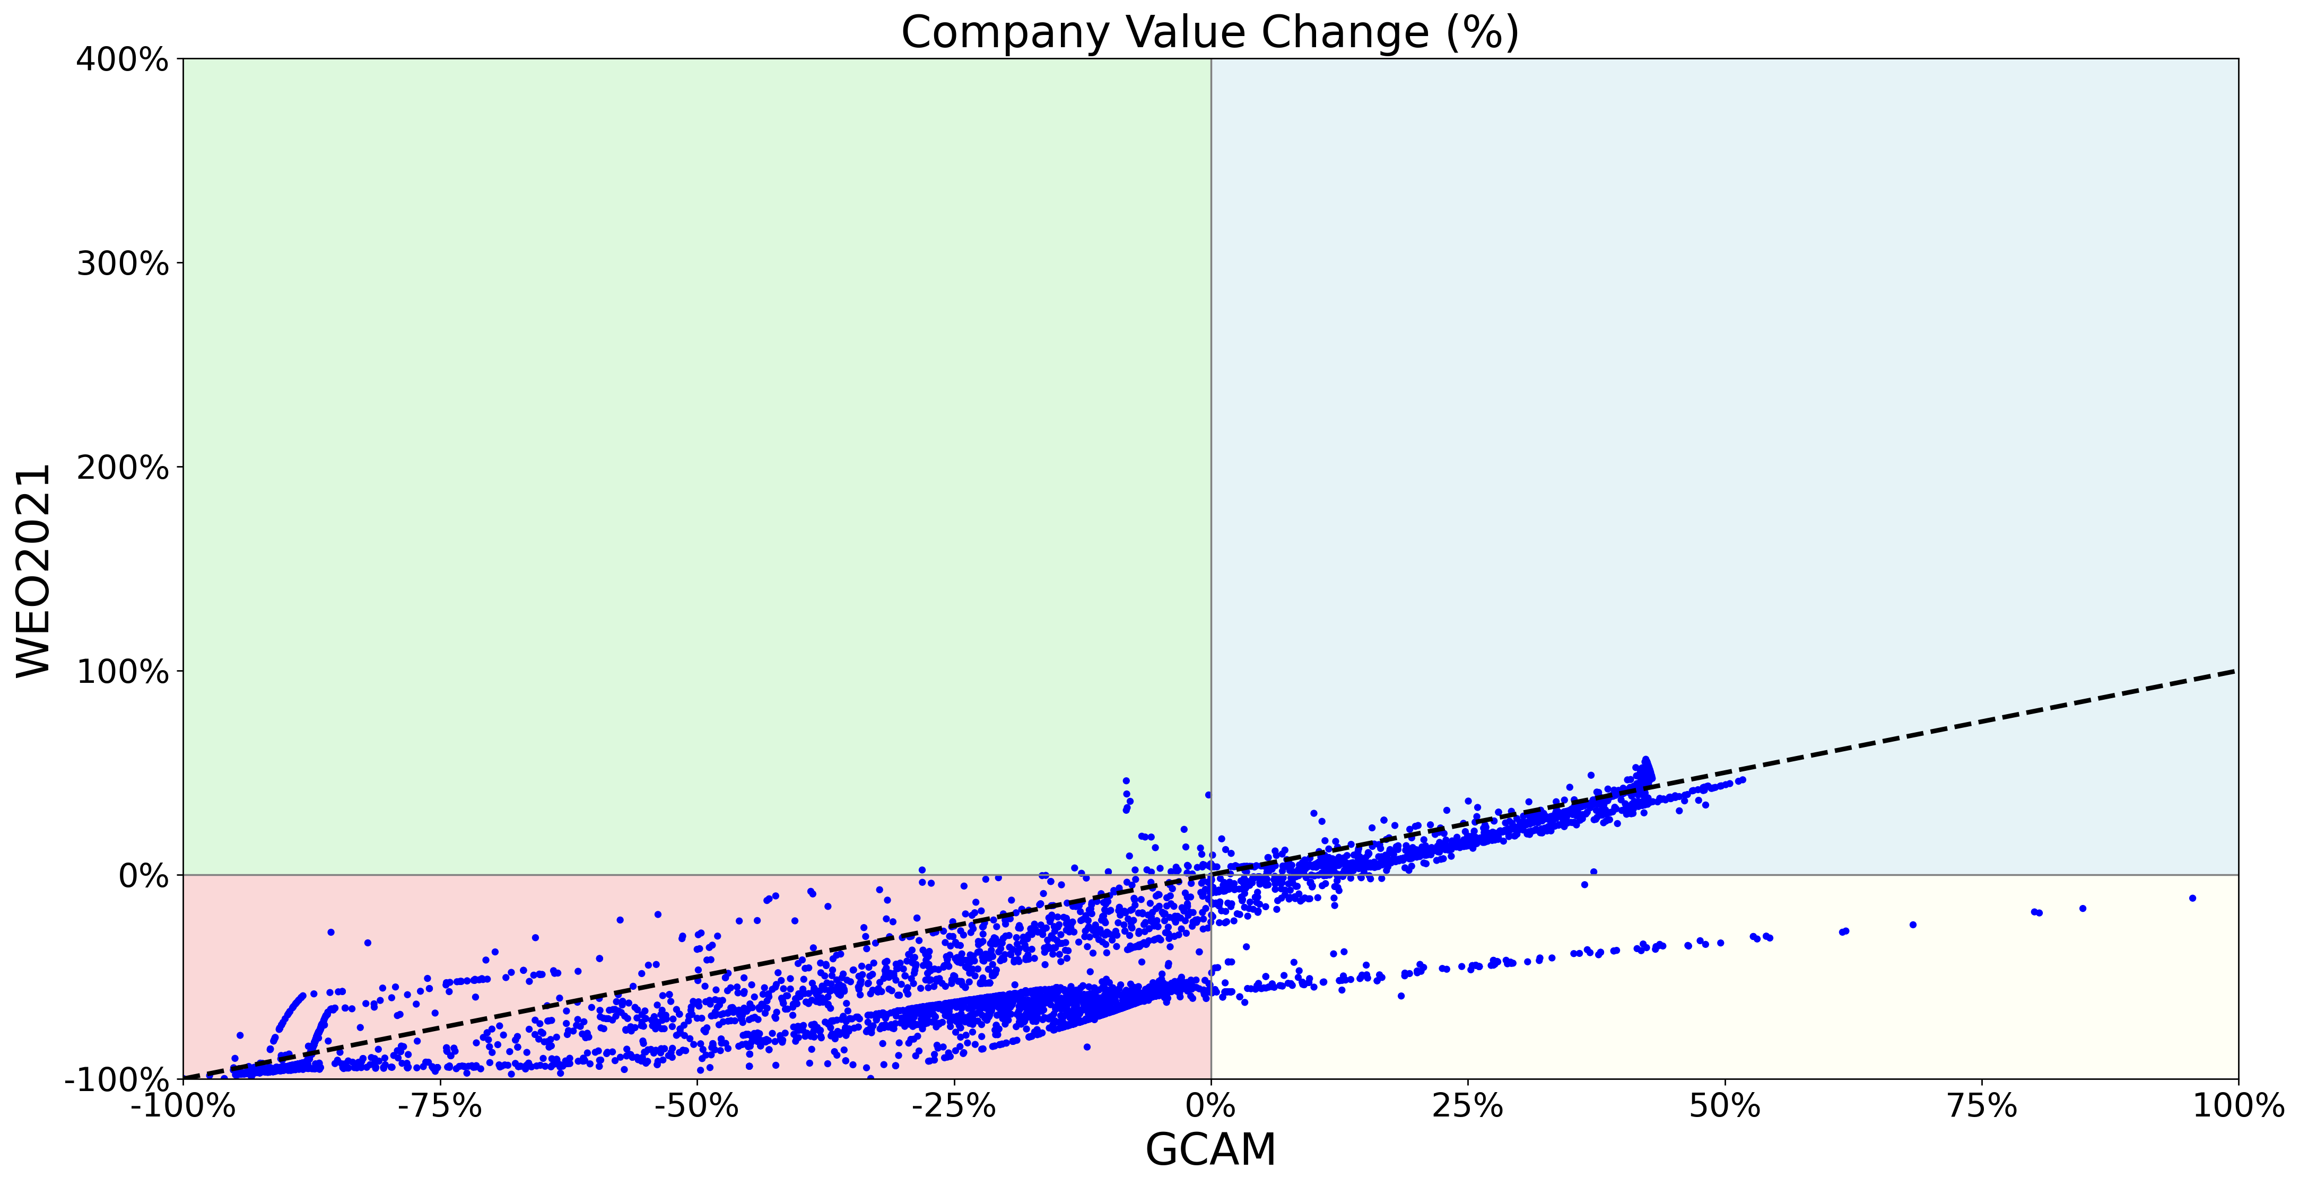
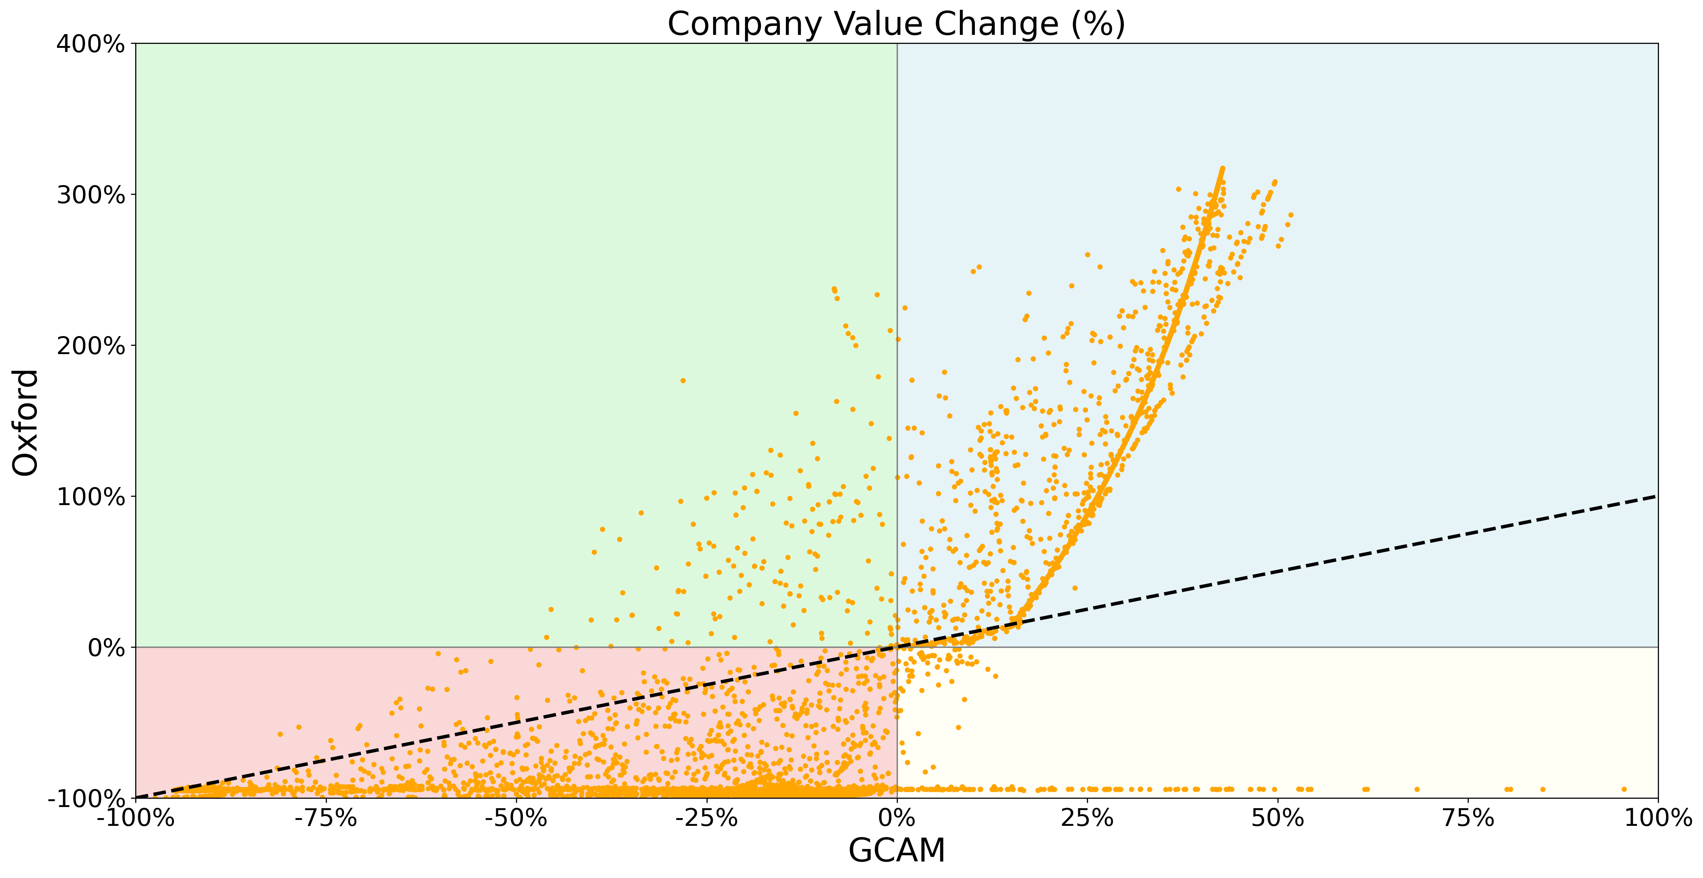
Breakdown by scenario – Valuation losses

Slide 12
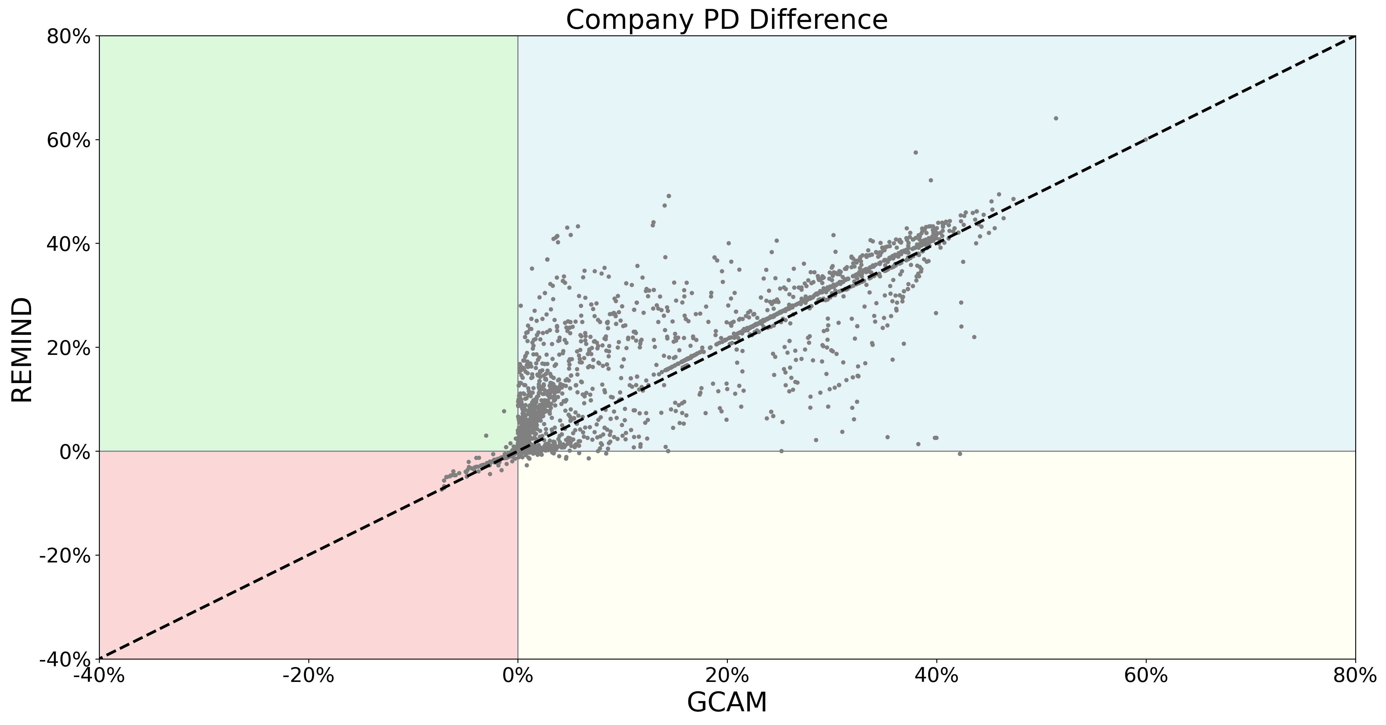
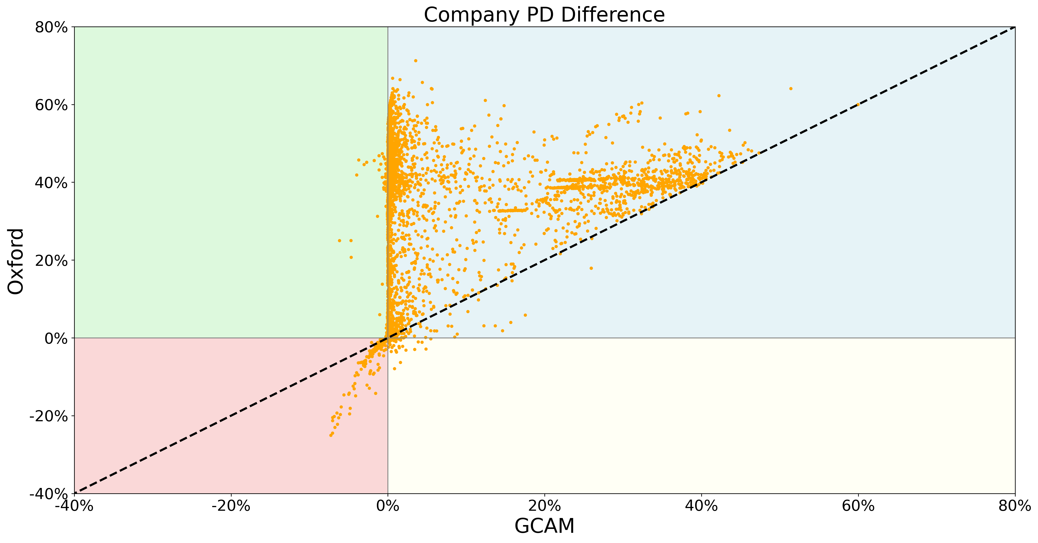
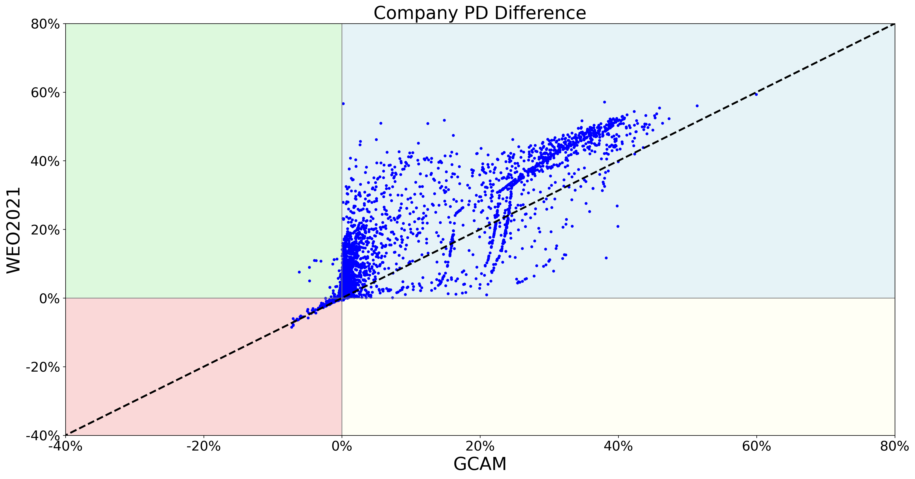
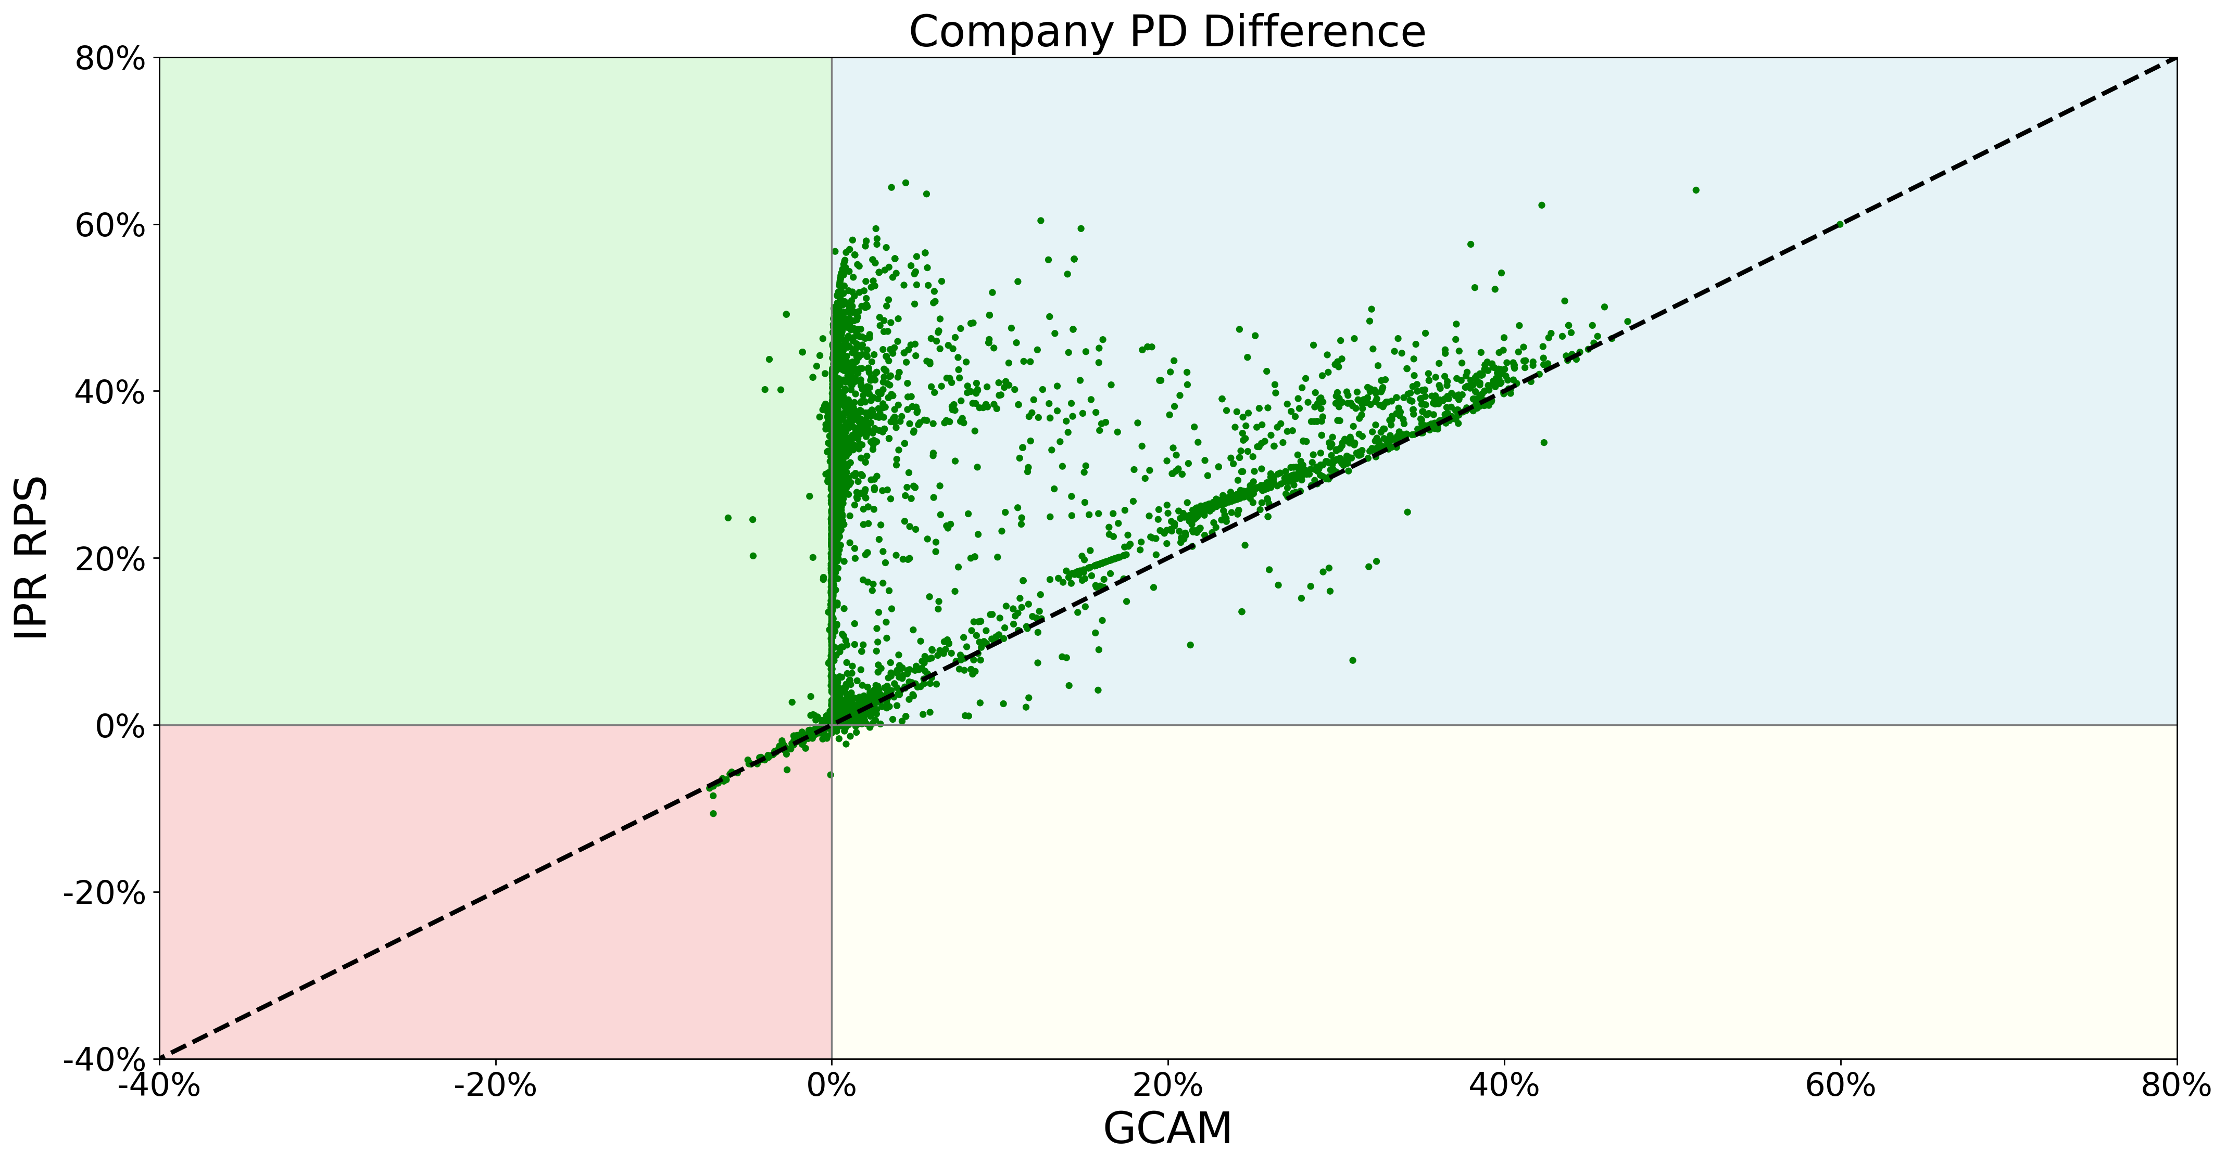
Breakdown by scenario – PD losses

Slide 13
FINDING #3: Even when filtering those companies that have a negative shock across scenarios, the overall shock levels can be dramatically different

Slide 14
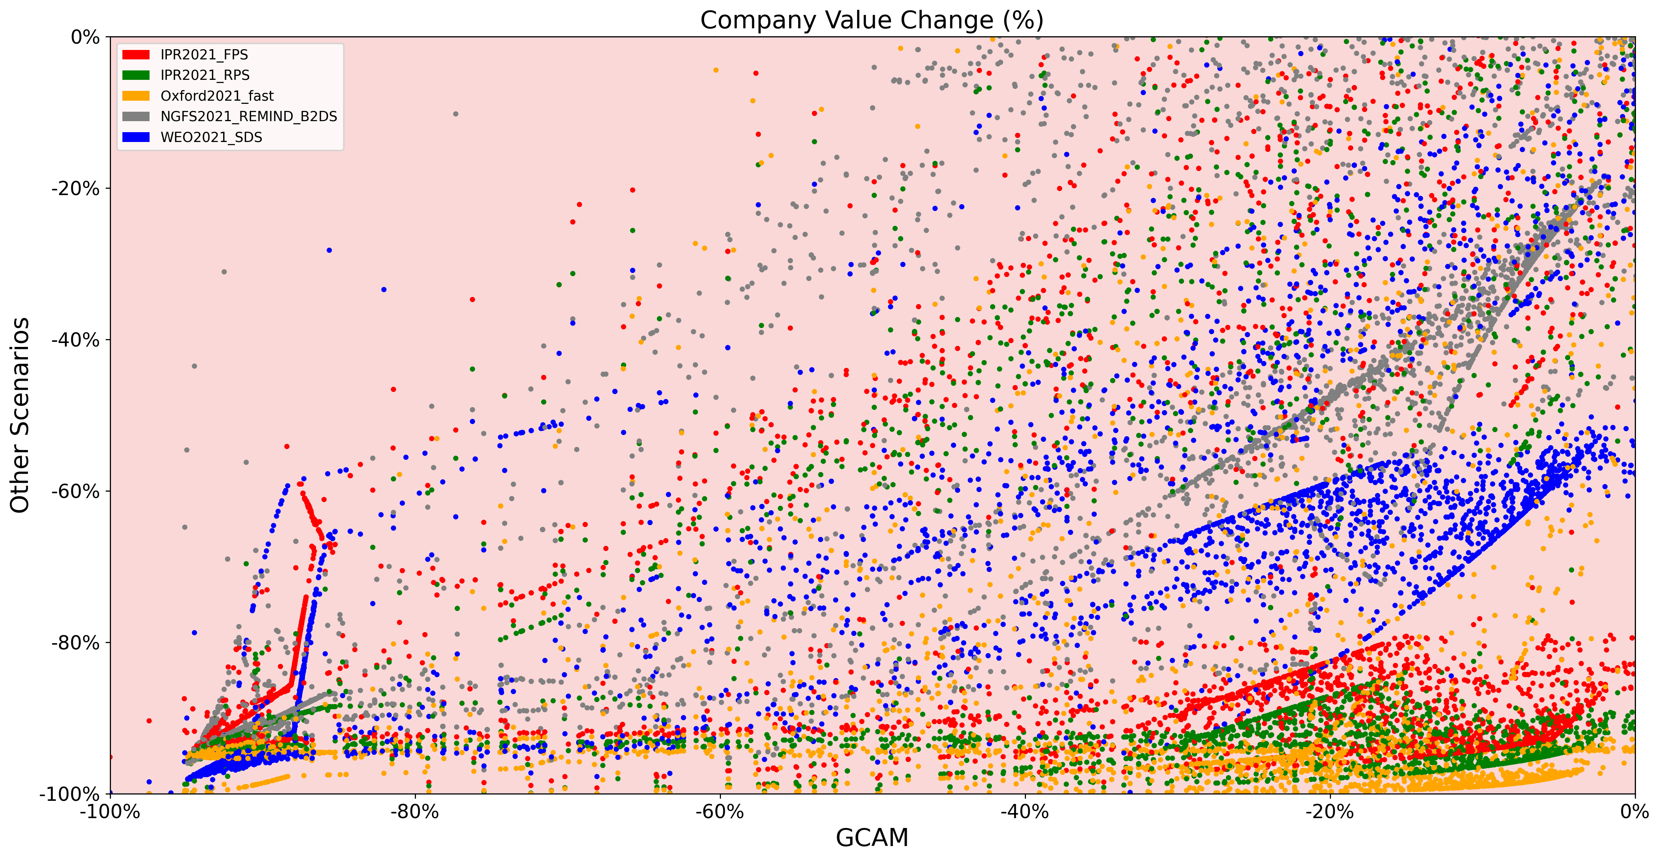
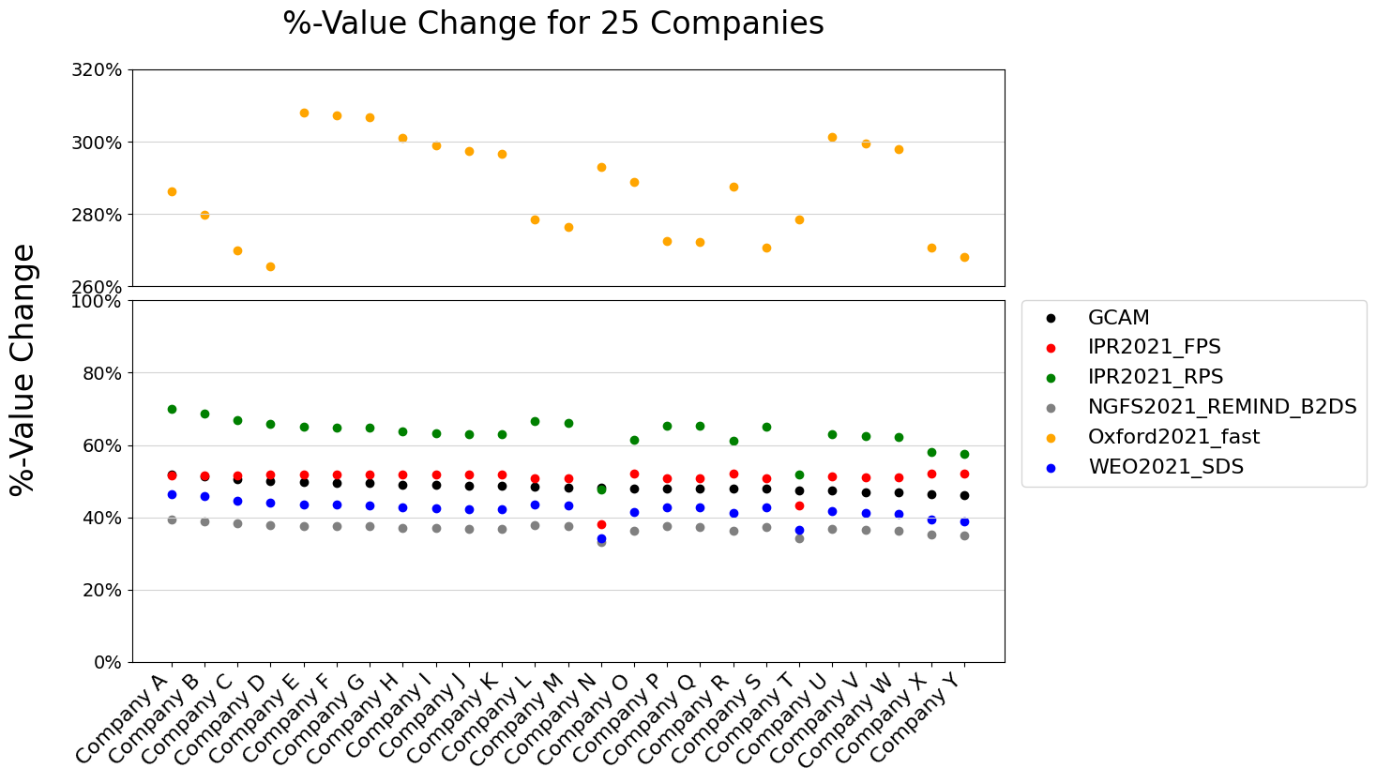
Key Finding #3: Even when filtering those companies that have a negative shock across scenarios, the overall shock levels can be dramatically different
The Figure below highlights that even when the scenarios have negative shocks for both scenarios, the actual correlation as to the size of the shock is effectively zero.
While the distribution provides some general trend, in particular insofar as there are almost no cases where the GCAM scenario has a high loss and other scenarios have a low loss, the inverse is not true. A large number of results cluster around an outcome with >80% loss in other scenarios and <20% loss for GCAM. The results also demonstrate some of the idiosyncrasies of climate stress-test models, with distributions at certain “tipping points” linear and in other places scattered randomly.
These findings are further highlighted by the dramatically different value changes of a sample of 25 companies with particularly significant differences (anonymized below).

Slide 15
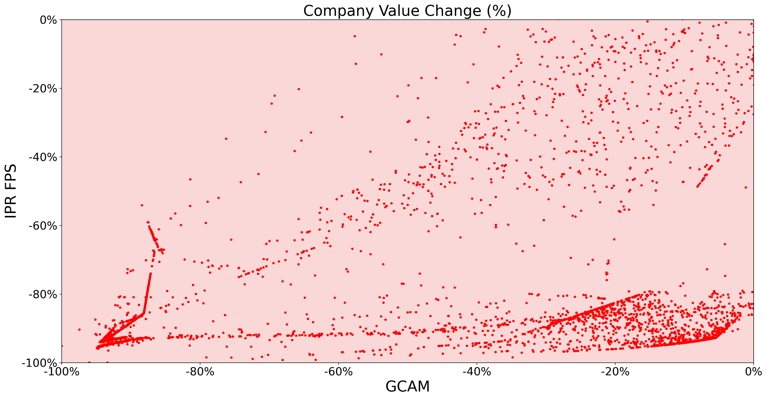
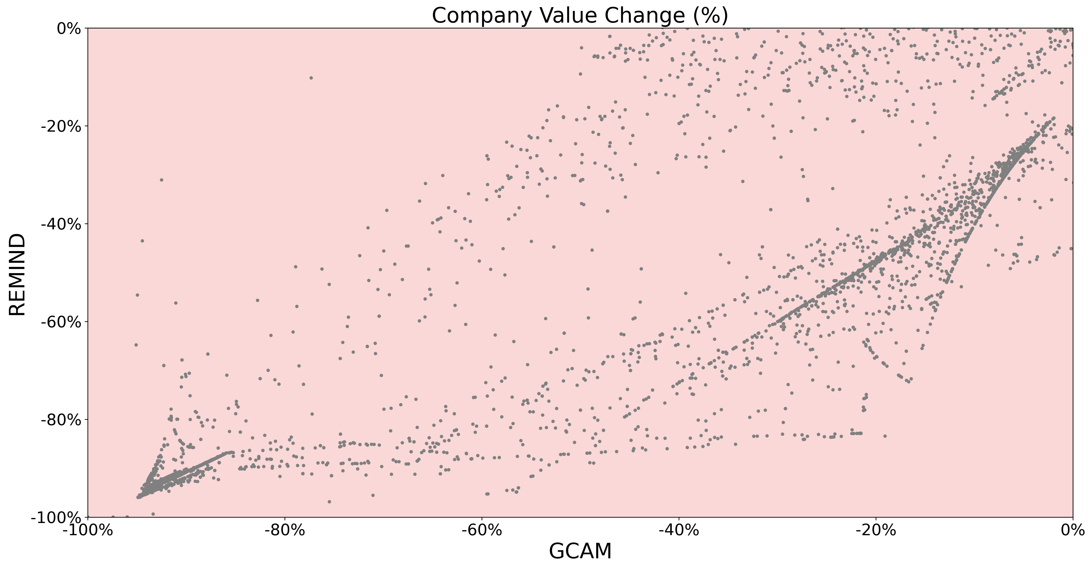
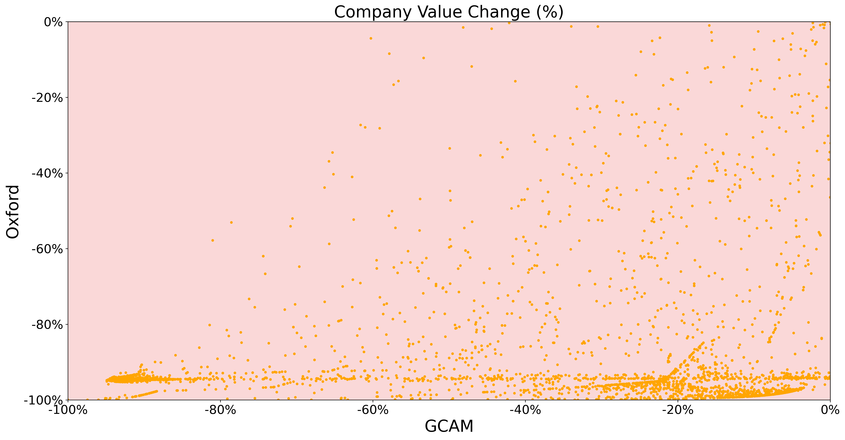
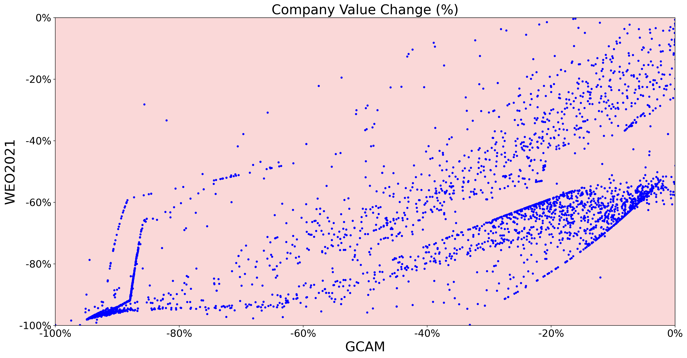
Breakdown by scenario – Valuation losses

Slide 16
FINDING #4: Crucially, the difference between NGFS scenarios suggest that the NGFS scenarios have a limited impact on comparability

Slide 17
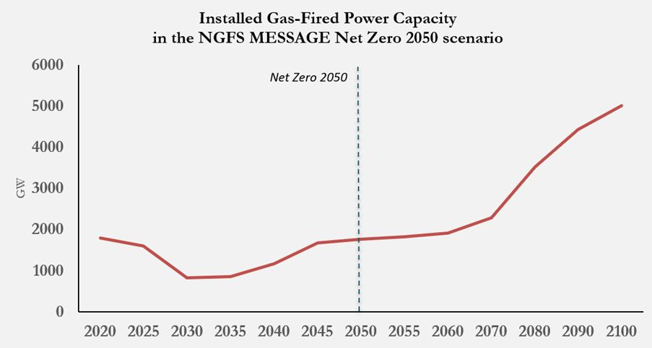
Key Finding #4: Crucially, the difference between NGFS scenarios suggest that the NGFS scenarios have a limited impact on comparability
The previous analysis has demonstrated the lack of correlation between the NGFS GCAM and REMIND scenarios.
The NGFS advertises their scenarios as “a global, harmonised set of transition pathways.” While the scenarios are surely “harmonized”, this does not yield consistent outcomes in stress-test scenarios. In fact, the analysis did not consider a third NGFS scenario (MESSAGE), given its dramatically different dynamic in the power sector, with significant increases to gas-fired power capacity for example until the end of the century. Including MESSAGE would have further skewed the results.
Thus, even users choosing only among NGFS scenarios will thus have a high degree of outcome sensitivity to their scenario input choice.

Slide 18
Implications
The analysis above highlights the high degree of sensitivity of stress-test outcomes to scenario inputs. This finding is not new intuitively, but the degree of that sensitivity even when using similar ambition level scenarios as part of a quantitative analysis is striking.
What is more, the analysis here is only limited to 5 scenarios and further scenarios would likely have also show different pictures. Crucially, this does not make the transition random. The overall results are consistently negative, even if different degrees, and we understand key distinctions between high-carbon and low-carbon trajectories. But the underlying results of these exercises are highly sensitive to their inputs.
Of course, it is also important to highlight caveats to the work. The analysis was run using one type of stress-test model and one type of data input, and thus other models and data sources may show different results and a larger degree of correlation.
Ultimately, this work reinforces the core recommendation of the 1in1000 programme to move away from individual sets of stress-test exercises to what we call “bulk stress-testing”, in order to address this results sensitivity
Technology improvements and computing capacities mean scenario simulations can now involve several 100 different scenario runs in parallel, as well as of course in parallel the capacity to assess the sensitivity to other model inputs (e.g. discount rate, terminal value). This study provides strong evidence that financial institutions and regulators need to consider a broader set of climate scenarios in stress-testing research which could have profound implications for policymakers. Controlled sensitivity analysis can also be a powerful mechanism to isolate the most material value drivers across these distributions and understand what drives the key differences in the results summarized in this note.

